Slide 1
Sid Swarupananda
Case Study 2
Attrition analysis at DDS Analytics

Slide 2
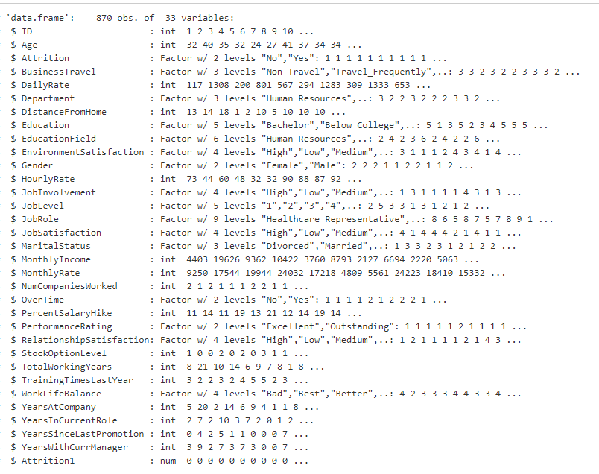
Dataset used in Analysis
Removed EmployeeCount, EmployeeNumber, Over18 and StandardHours which are not relevant to our analysis
No missing values in the dataset
Attribution values Yes (19%) and No (81%)

Slide 3
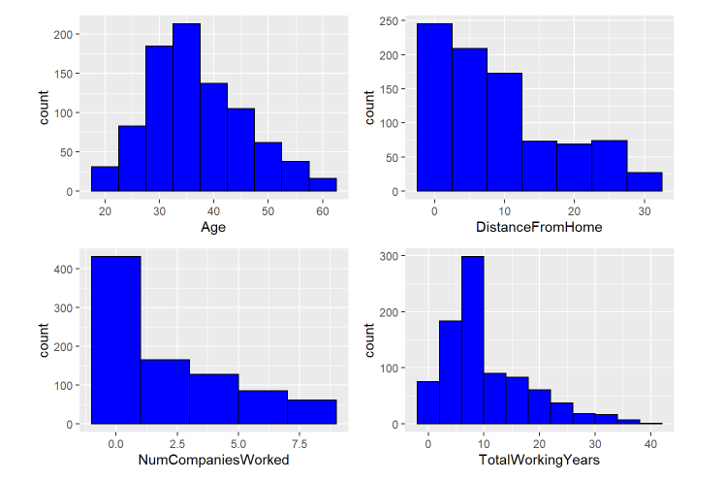
Workforce Overview
Age is more or less normally distributed.
Distance From Home, Number of Companies Worked and Total working years are right skewed.

Slide 4
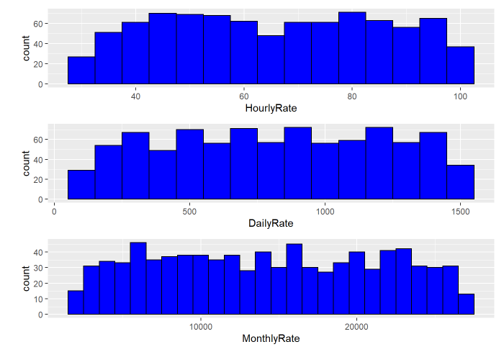
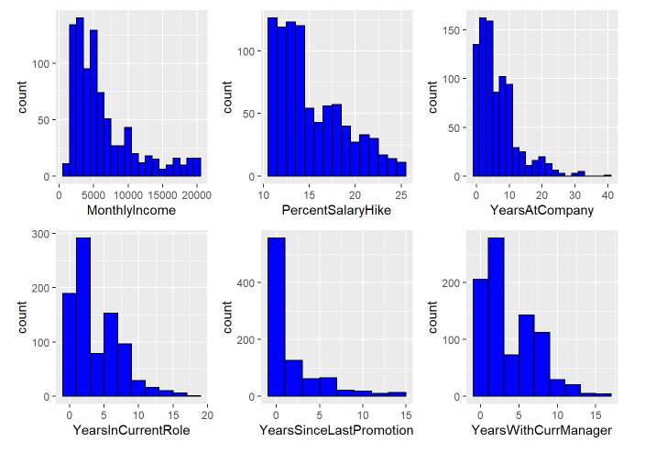
Workforce Overview
No clear pattern with rates

Slide 5
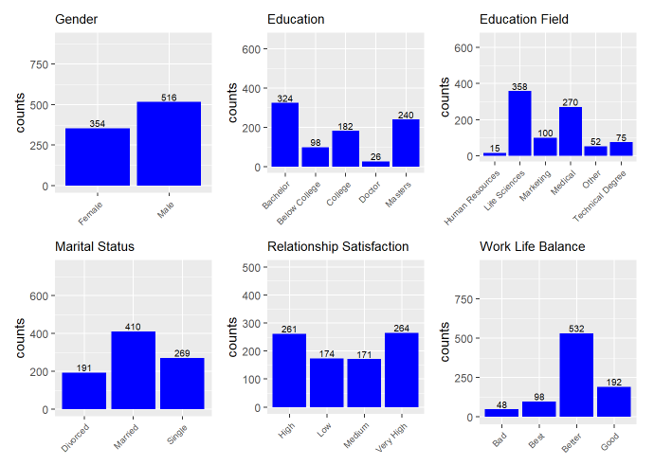
Workforce Overview
More than 50% of Male population.
More than 36% are having a bachelors degree and 27% are having a masters degree.
Almost 70% of the employees come from Life Sciences and Medical background.
47% of the employees are married whereas 22% of them are divorced.
More than 30% of the employees have a High or Very High Relationship Satisfaction.
More than 60% of the employees feel they have a better work life balance.

Slide 6
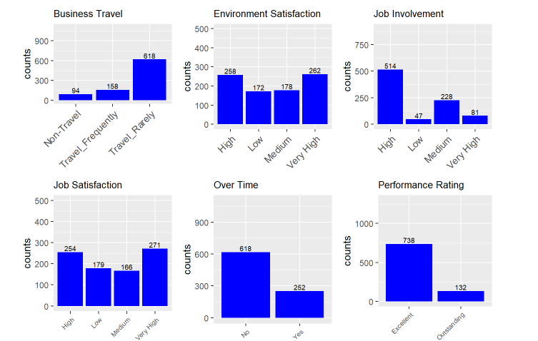
Workforce Overview
More than 70% of the employees Travel rarely for work.
30% of the employees have a high and very high environment satisfaction each.
Almost 59% of the employees think they have a High job involvement at work.
Again in Job Satisfaction we see that 30% employees have a high and a very high job satisfaction each.
More than 70% of the people seem to be working over time.
85% of the employees have an excellent performance rating.

Slide 7
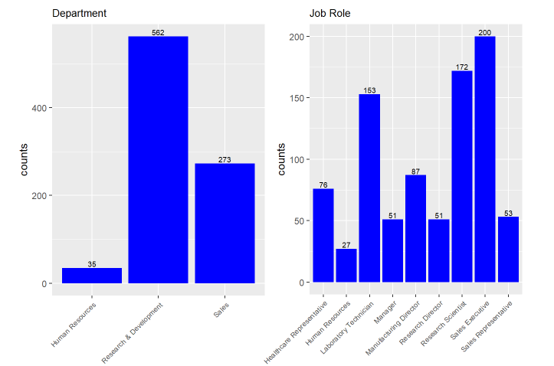
Workforce Overview
More than half of the employees work for the R&D department.
Majority of the employees work as Sales Executives, Research Scientists and Laboratory Technicians.

Slide 8
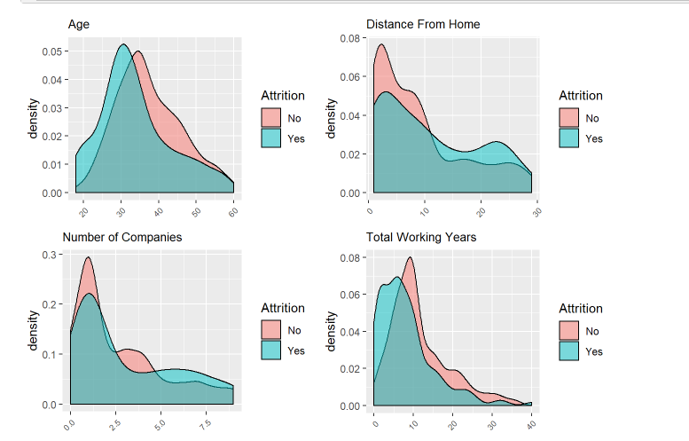
Attrition Analysis
Younger employees within 25-35 years have a higher attrition rate.
We see a lower attrition rate when the Distance from home is within 10 kms. The attrition rate increase post 10kms.
The attrition rate tends to be higher with employees who have worked with 5 to 7 companies.
Attrition rate seems to be extremely high amongst employees who have a total working experience between 0 to 7 years approximately.
Notes:
After looking at each feature individually, we did some bivariate / multivariate analysis to predict attrition. Here we explored independent variables with respect to the target variable. The objective was to discover hidden relationships between the independent variables and the target varaible

Slide 9
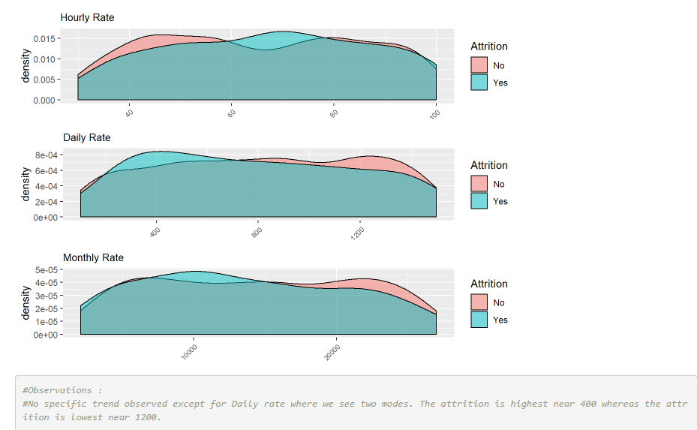
Attrition Analysis

Slide 10
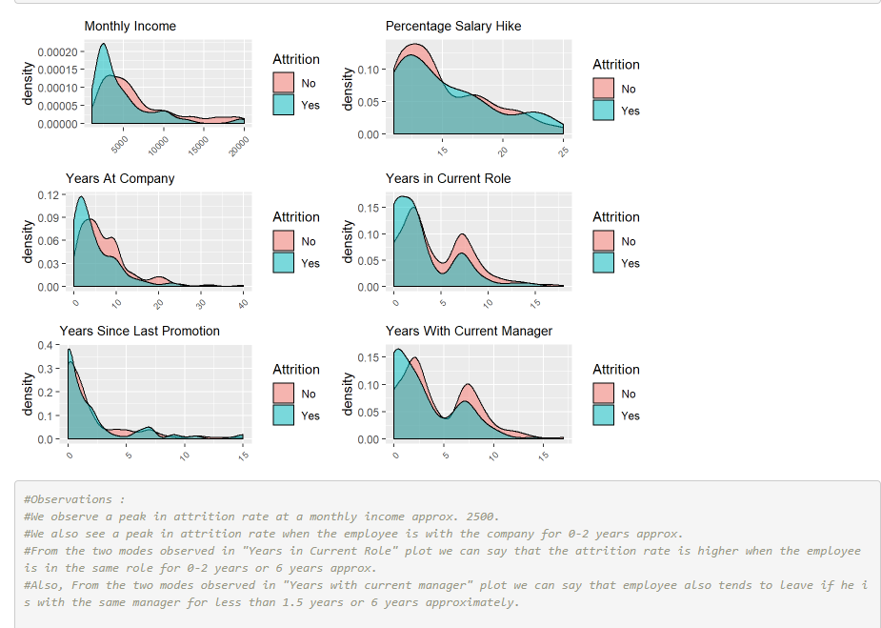
Attrition Analysis

Slide 11
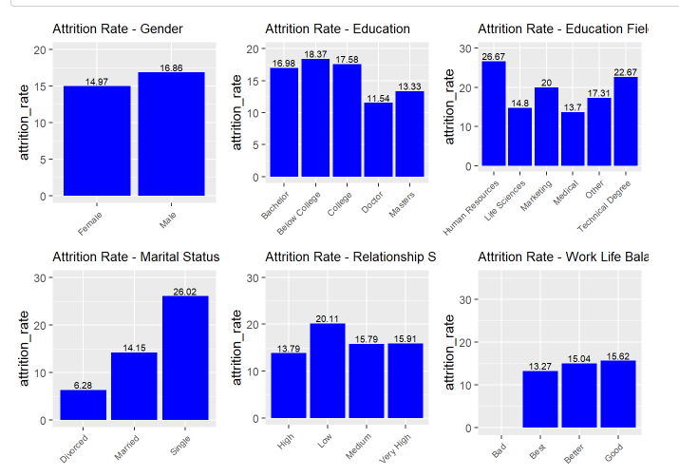
Attrition Analysis
Attrition Rate is slightly more in Males as compared to Females.
18% attrition rate is observed amongst employees have below college education.
Attrition rate is very high amongst employees from HR, Marketing and Technical backgrounds.
As expected, the attrition rate is very high amongst employees who have a bad work life balance.

Slide 12
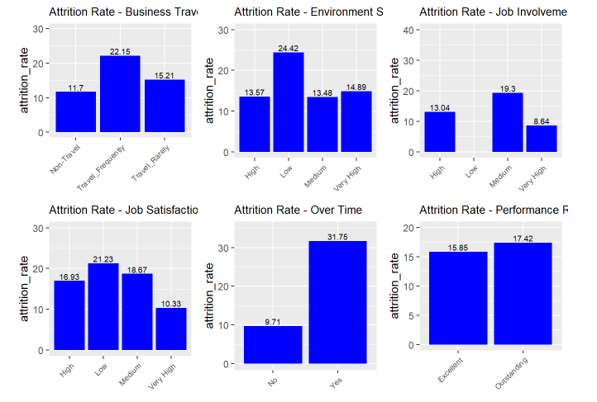
Attrition Analysis
Attrition rate is higher amongst people who travel frequently.
It is also higher amongst employees who have a low environment satisfaction, low job involvement and low job satisfaction.
The attrition rate is almost 30% amongst employees who work over time.

Slide 13
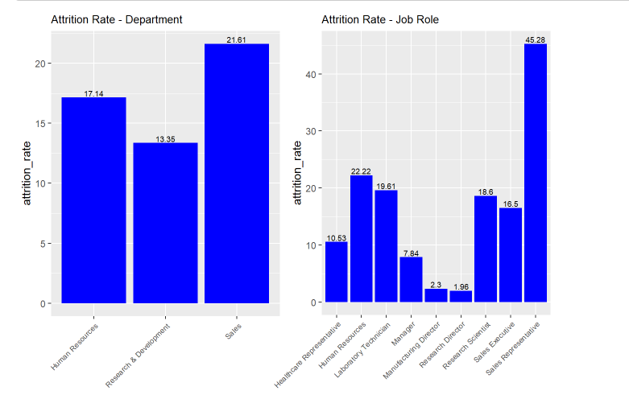
Attrition Analysis
Sales department have the highest attrition at 20% whereas Sales Representatives have the highest attrition at 40%.

Slide 14
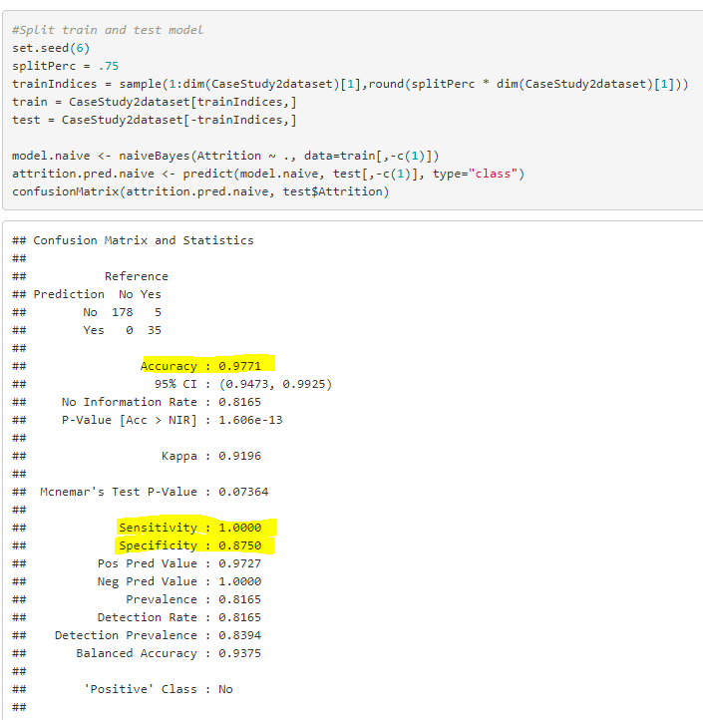
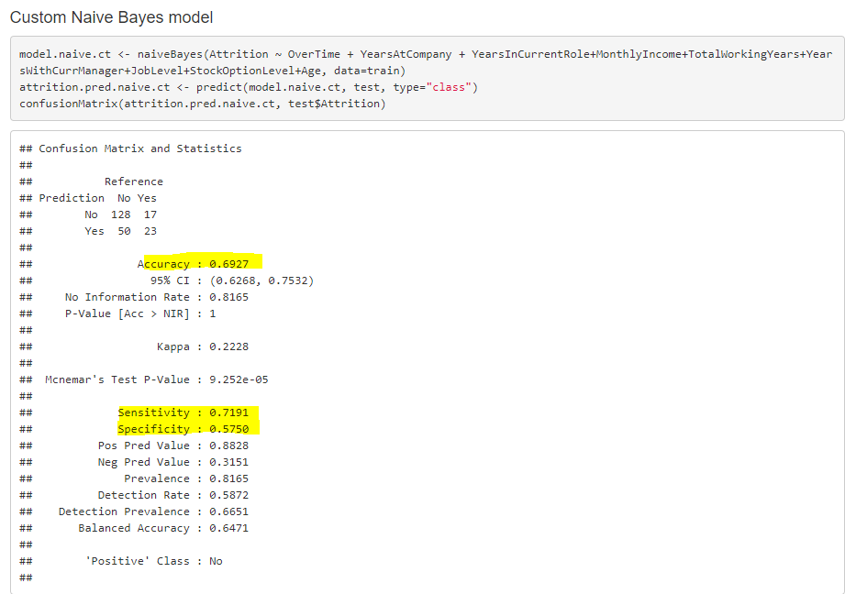
Predicting Employee turnover with Naïve Bayes machine learning model

Slide 15
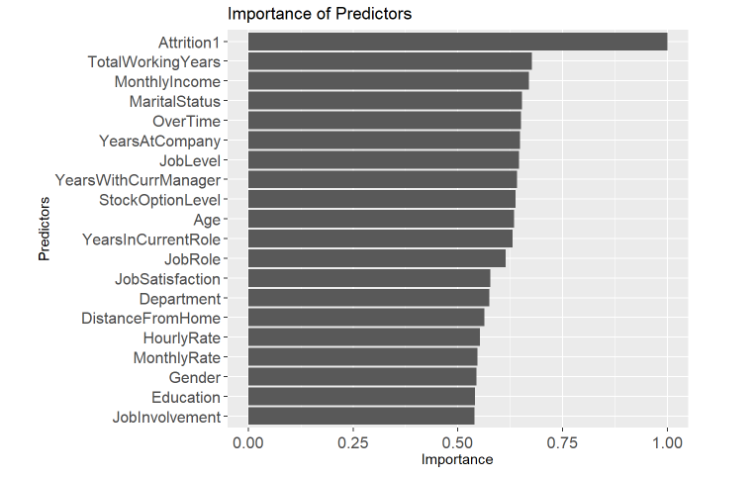
Top Predictors for attrition based on Naïve Bayes machine learning model

Slide 16
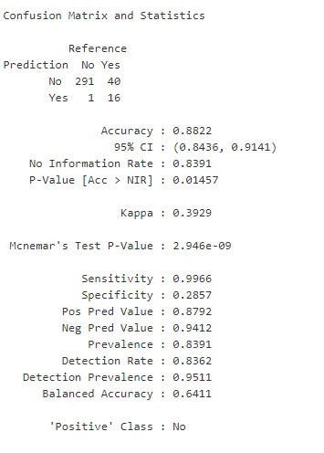
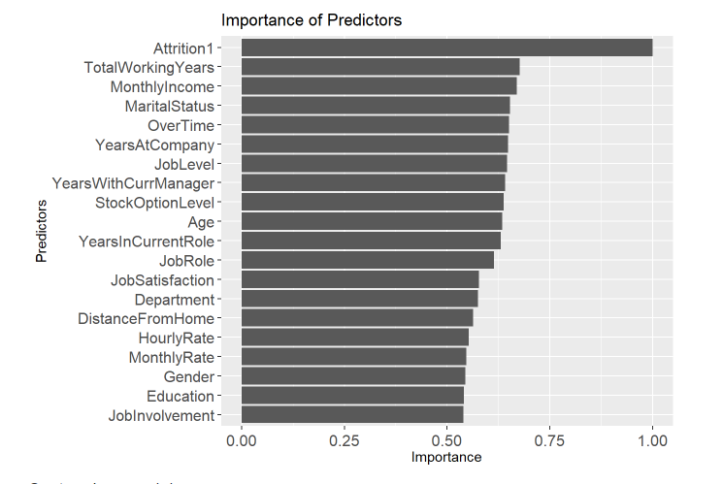
Predicting Employee turnover with Knn machine learning model
Based on the output of both the models, KNN model has high accuracy and sensitivity but specificity is only 29%. Naïve Bayes model meets all the criteria required for Accuracy, Sensitivity and Specificity being over 57%
Notes:
Two models were compared Naive bayes and Knn. Of the two classification models Naive bayes was found to consistently have better overall scores in Accuracy Sensitivity and Specificity. We recommend this model as a good model to start with to predict turnover but also believe the model can be improved with more research.

Slide 17
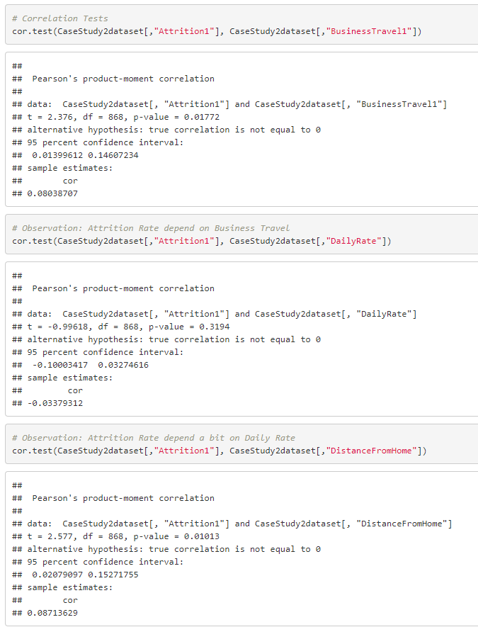
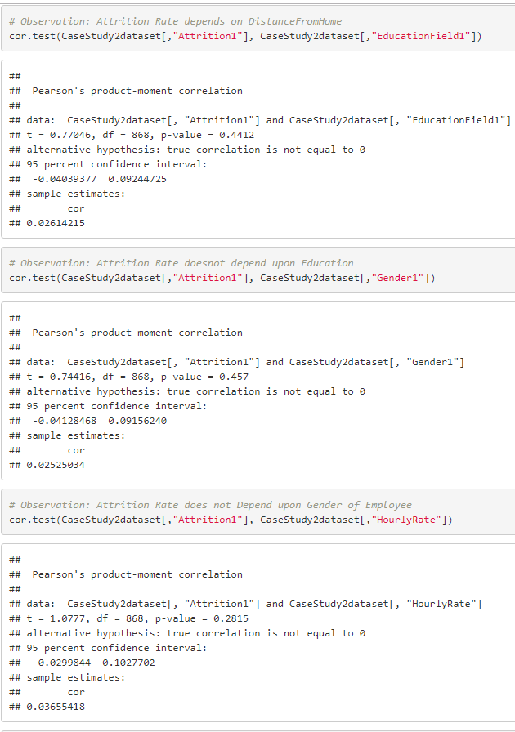
Correlation Tests to predict Attrition

Slide 18
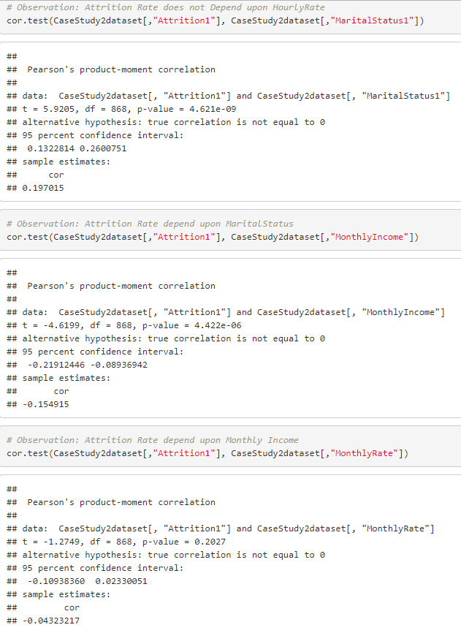
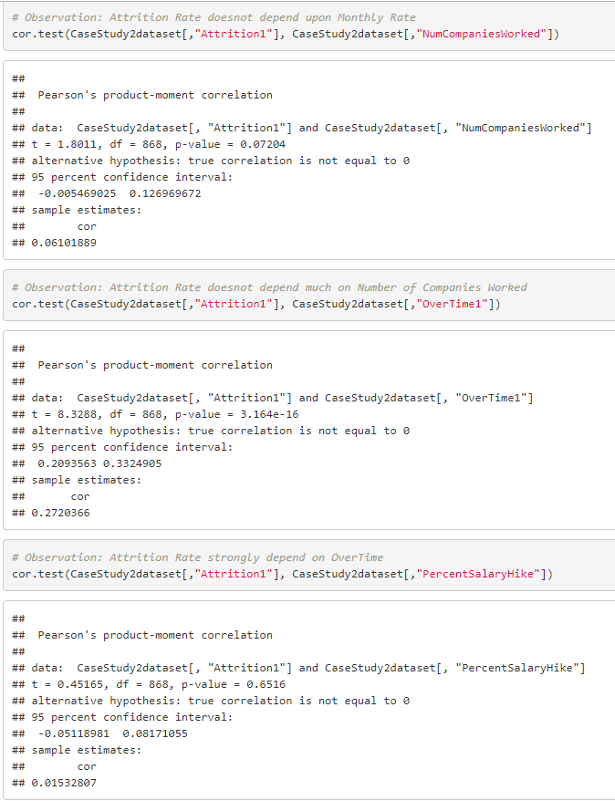
Correlation Tests to predict Attrition

Slide 19
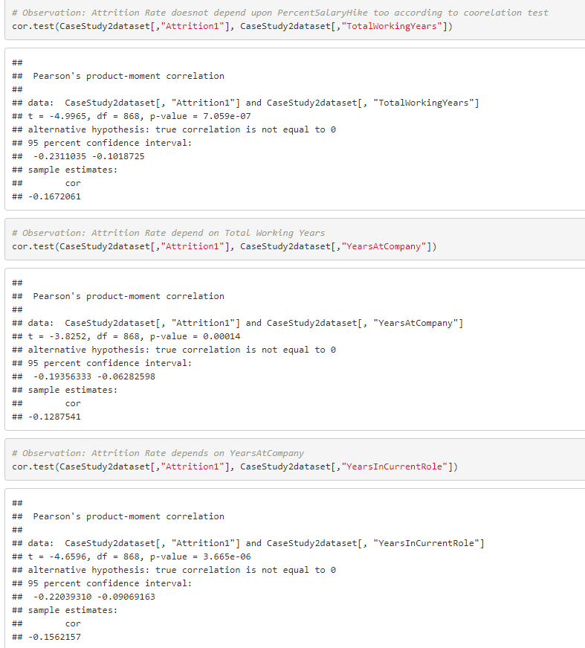
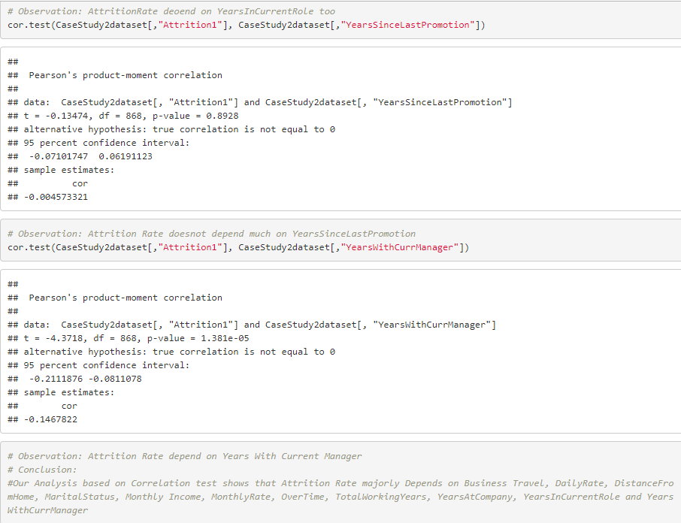
Correlation Tests to predict Attrition

Slide 20
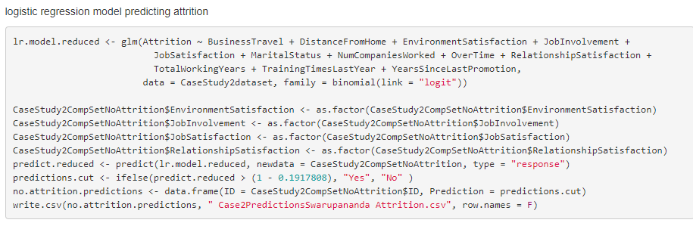

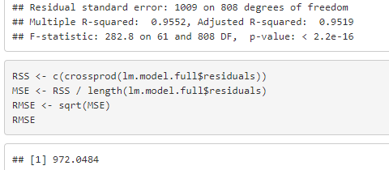
Logistic regression model predicting Attrition and Linear regression model predicting Salary

Slide 21
Conclusion
Job roles most likely to leave
Sales Reps
Human Resources
Lab Techs
Top three factors leading to turnover
Years in Workforce
Monthly Income
Marital status
Best predictive model Naïve Bayes

